Slide 1
Dynamic Analysis – Establish Settings
AVCDL-Implementation-8.1.1
Charles Wilson
Staff Product Cybersecurity Architect
version 2
2025-10-06
Notes:
Script:
I'm Charles Wilson, staff product cybersecurity architect at Torc Robotics.
This presentation will cover the Dynamic Analysis Settings Establishment activity.

Slide 2
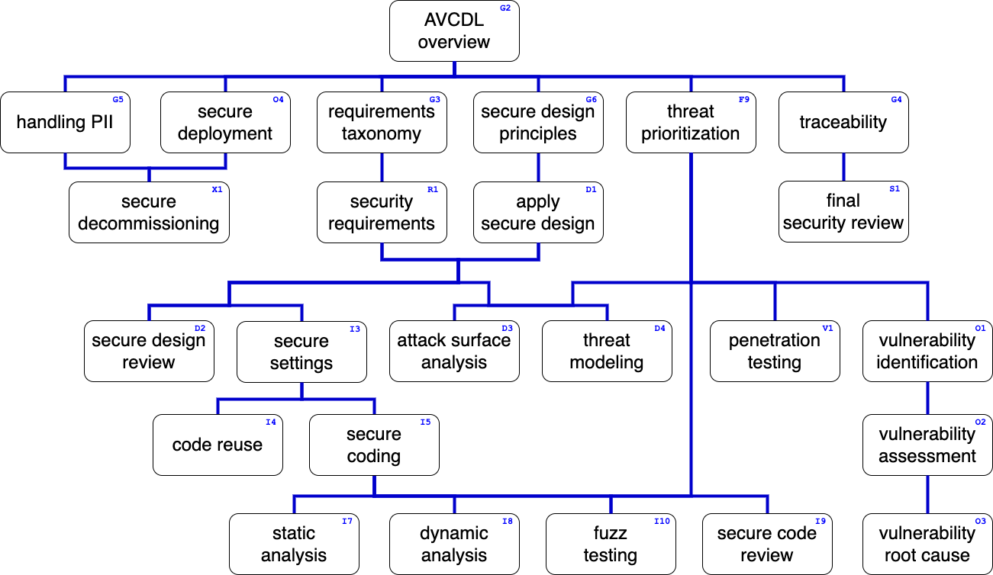
Training Path
Notes:
Script:
This diagram shows the overall AVCDL training path.
If you're taking this training, it's assumed that you've already completed the AVCDL Overview training,
and additionally, that you've completed the
Requirements Taxonomy
Security Requirements
Secure Design Principles
Apply Secure Design
Threat Prioritization
Secure Settings
Secure Coding
and
Dynamic Analysis Overview
trainings.
This training will cover Dynamic Analysis Settings Establishment.

Slide 3
Introduction
Notes:
Script:
Before getting into settings establishment, let's briefly review where it fits, in the overall dynamic analysis process.

Slide 4
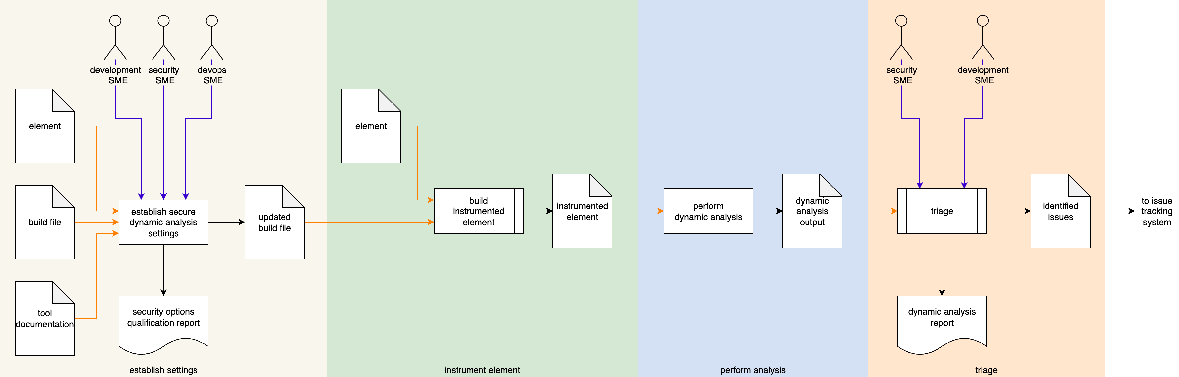
Dynamic Analysis Process
Notes:
Script:
Here's the dynamic analysis process which we previously covered in the Dynamic Analysis Overview.
[break]
Our focus for this training is going to be on the first activity, that of settings establishment.

Slide 5
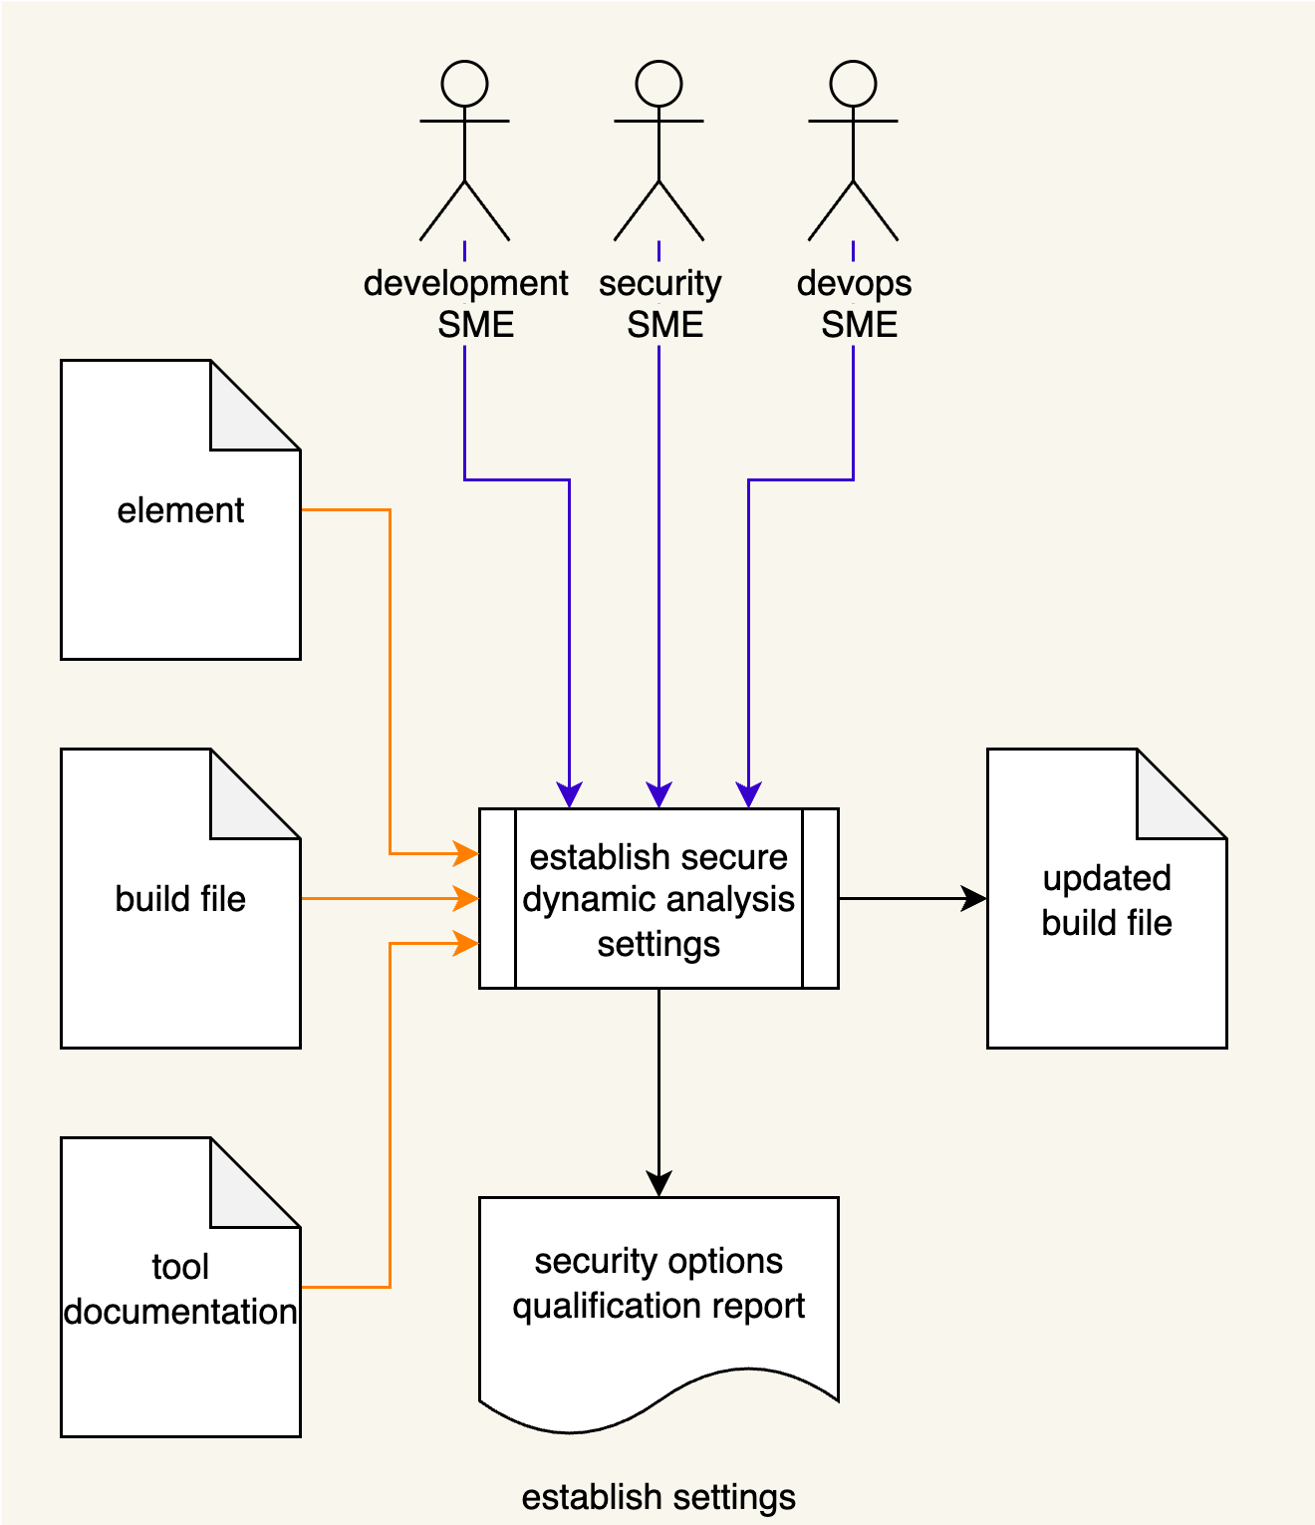
Dynamic Analysis Process
Notes:
Script:
Here's the dynamic analysis process which we previously covered in the Dynamic Analysis Overview.
[break]
Our focus for this training is going to be on the first activity, that of settings establishment.

Slide 6
Establish Settings Activity
Notes:
Script:
Within the settings establishment activity,
The development, security, and devops SMEs take
[pause]
the tool documentation,
[pause]
element documentation
[pause]
and build file,
[pause]
and establish a set a of element-specific settings,
[pause]
creating an updated build file
[pause]
and generating a security options qualification report.
[pause]
Now if this diagram seems really information-dense, that's because this is the encapsulation of the secure settings process.
Let’s revisit that process.

Slide 7
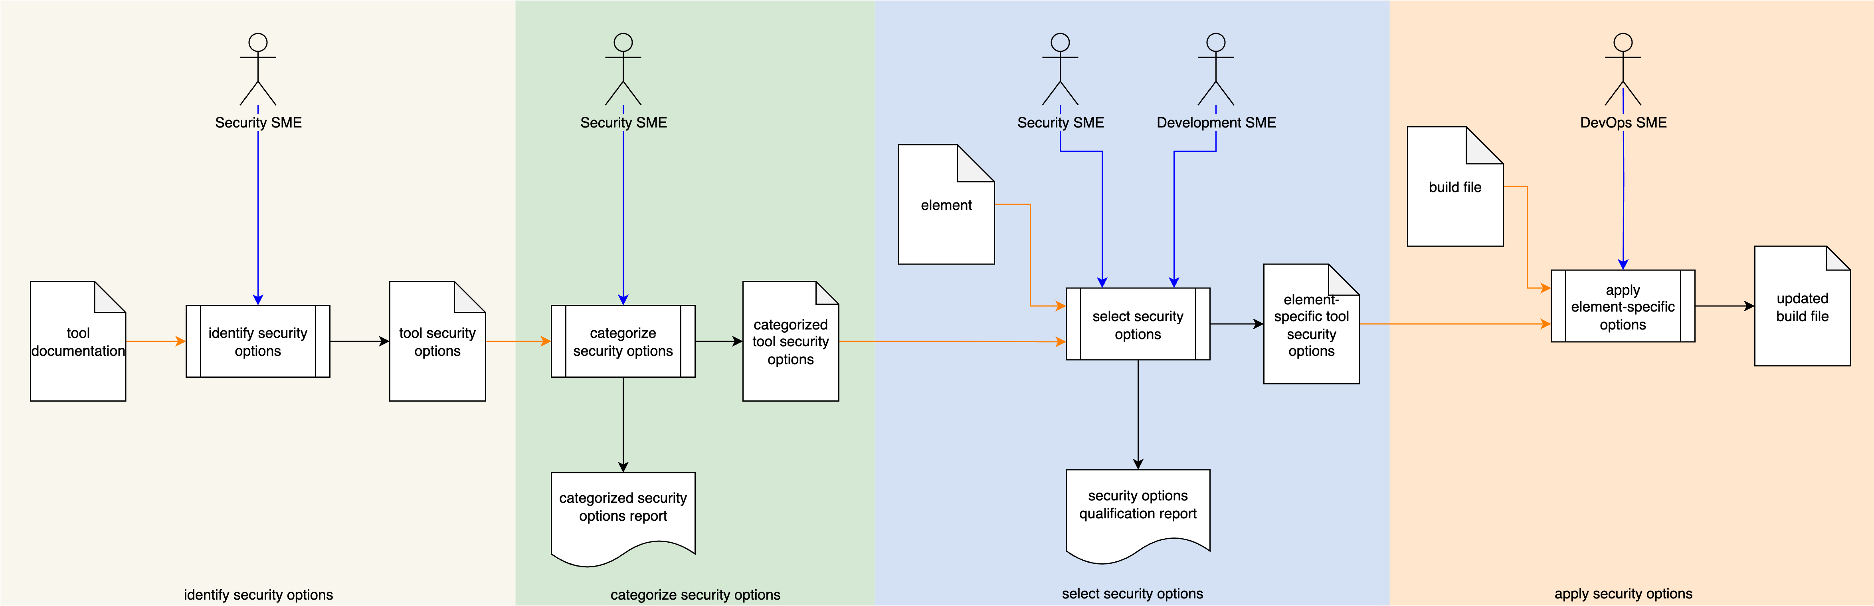
Secure Settings Process
Notes:
Script:
The secure settings process is comprised of four activities.
These are:
[break]
identifying the options relevant to security
[break]
categorizing those options
[break]
selecting which ones we're going to use for each element
[break]
and finally, applying those options to the build system for that element.

Slide 8
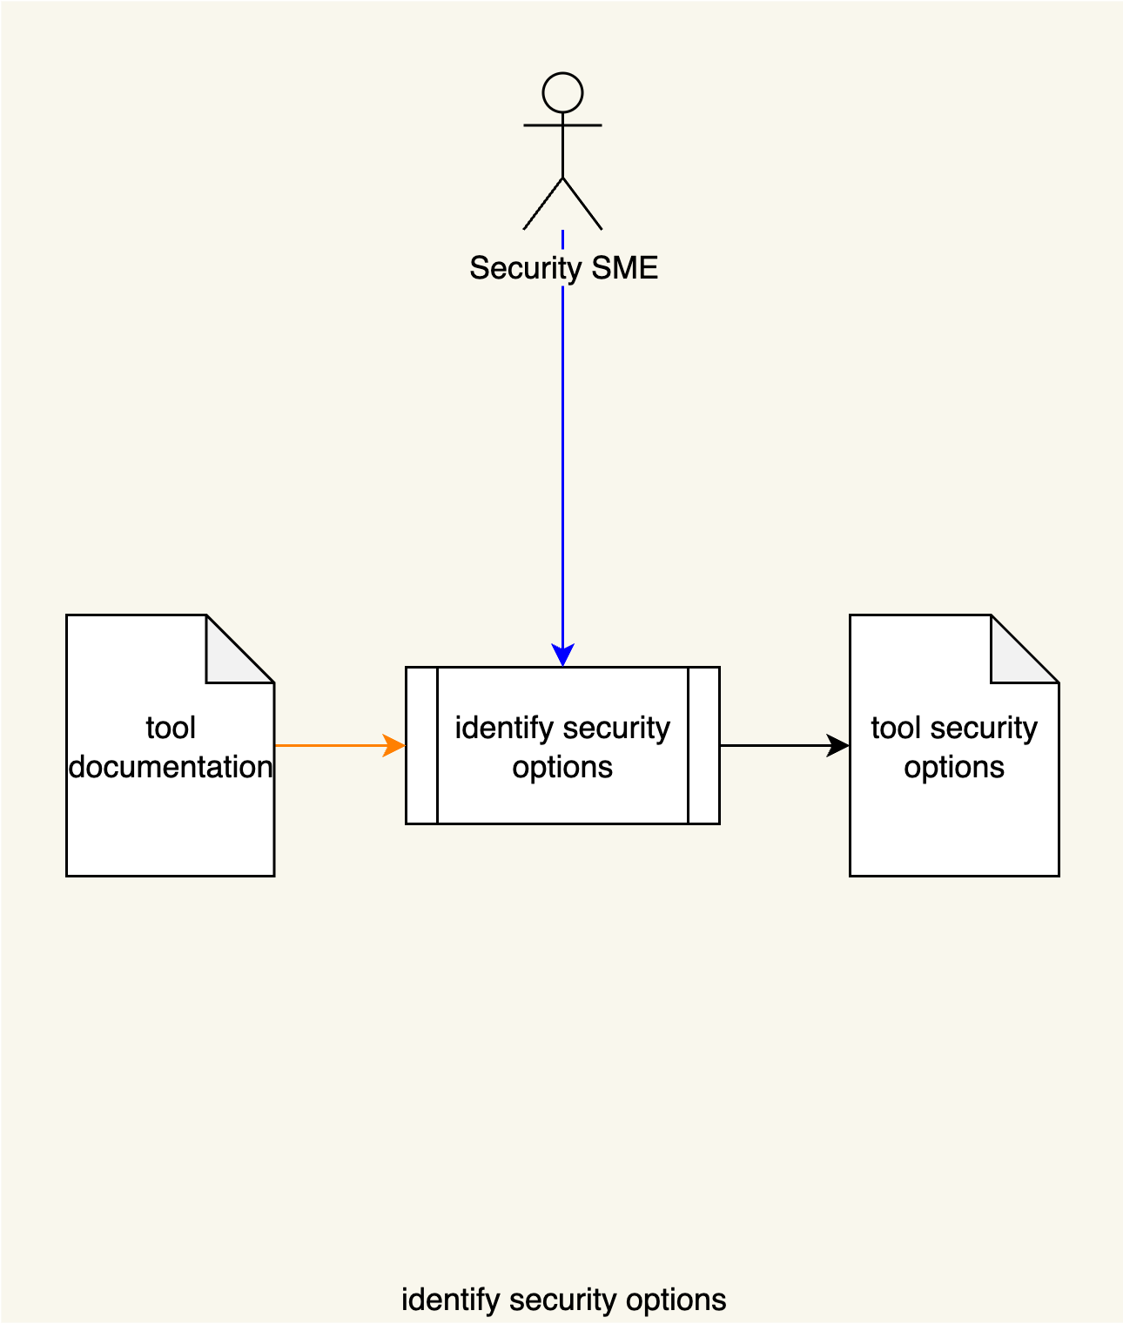
Secure Settings Process
Notes:
Script:
The secure settings process is comprised of four activities.
These are:
[break]
identifying the options relevant to security
[break]
categorizing those options
[break]
selecting which ones we're going to use for each element
[break]
and finally, applying those options to the build system for that element.

Slide 9
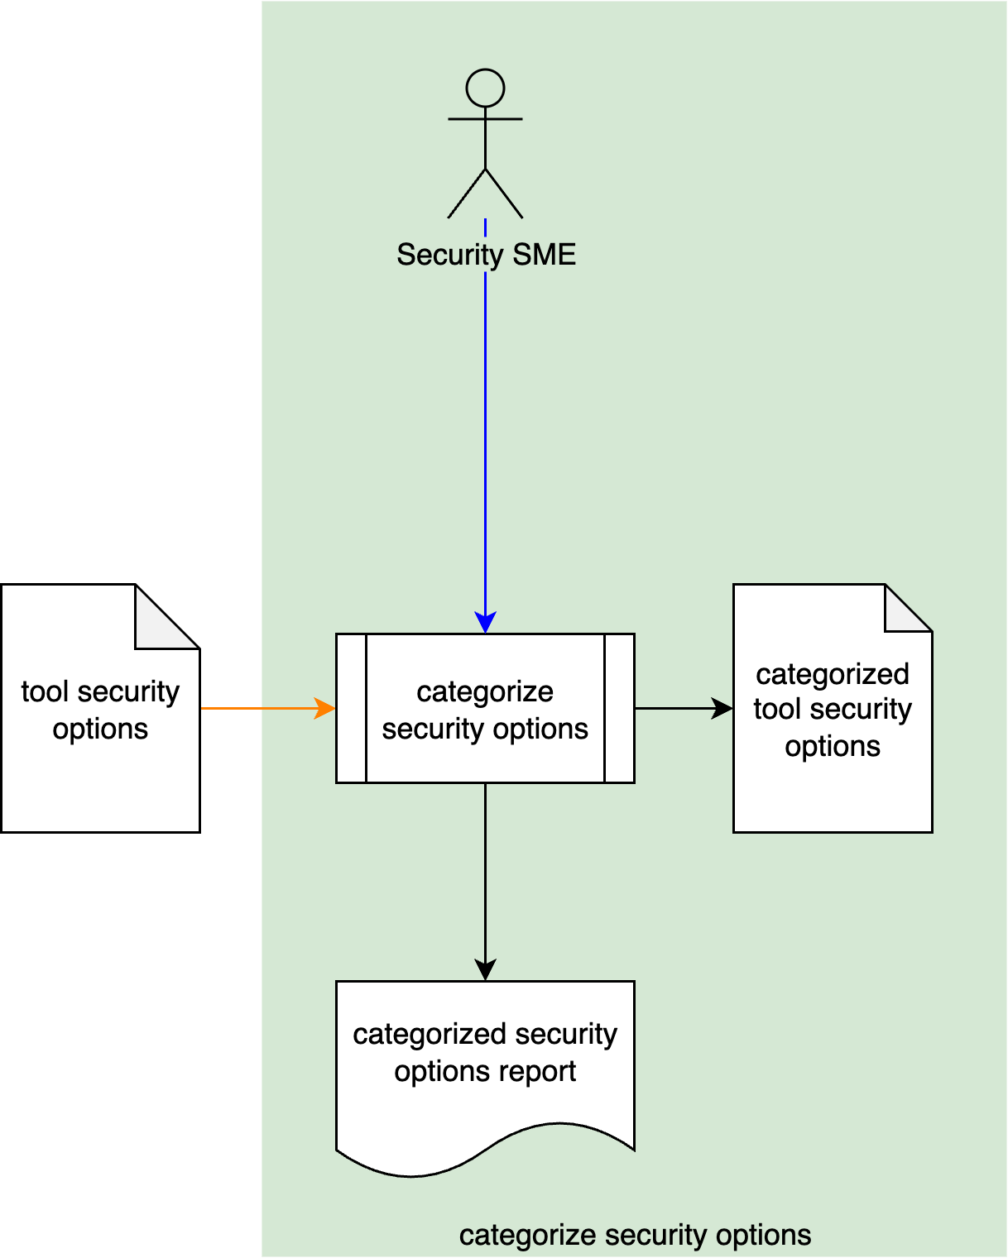
Secure Settings Process
Notes:
Script:
The secure settings process is comprised of four activities.
These are:
[break]
identifying the options relevant to security
[break]
categorizing those options
[break]
selecting which ones we're going to use for each element
[break]
and finally, applying those options to the build system for that element.

Slide 10
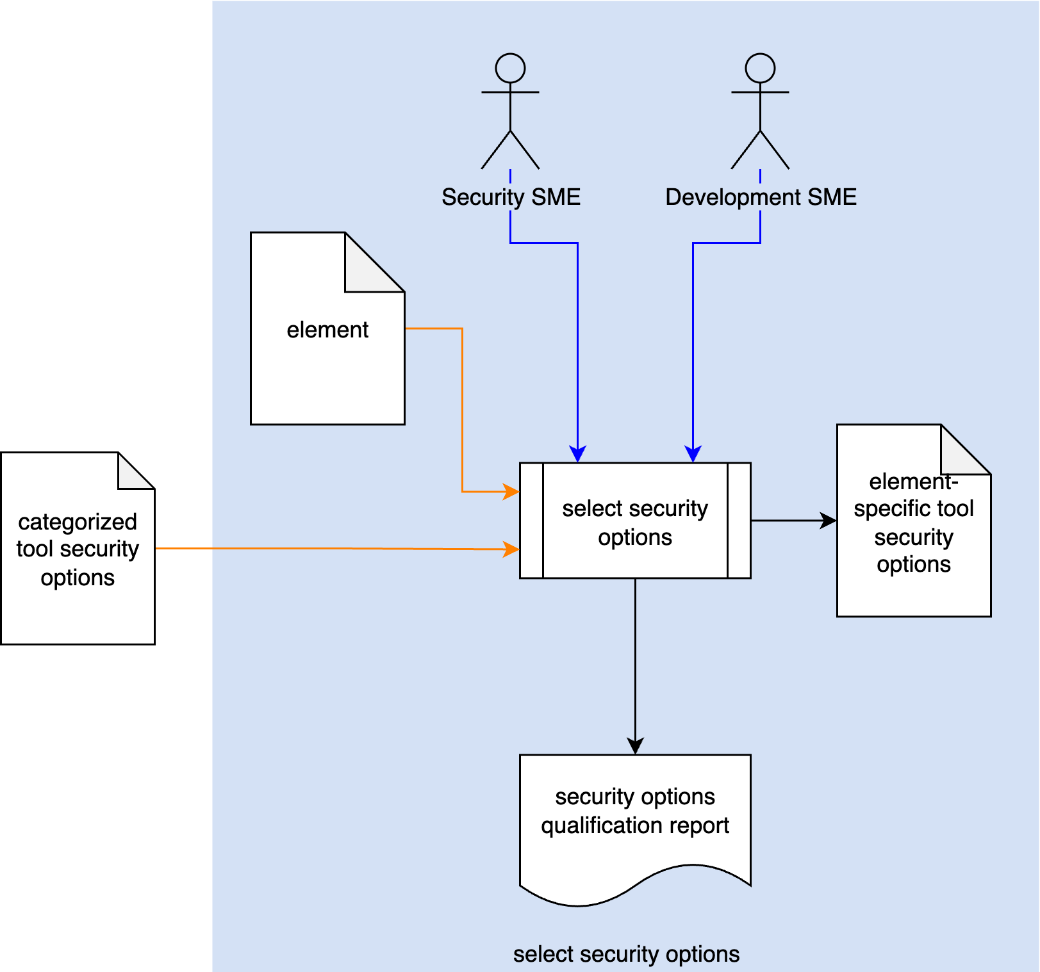
Secure Settings Process
Notes:
Script:
The secure settings process is comprised of four activities.
These are:
[break]
identifying the options relevant to security
[break]
categorizing those options
[break]
selecting which ones we're going to use for each element
[break]
and finally, applying those options to the build system for that element.

Slide 11
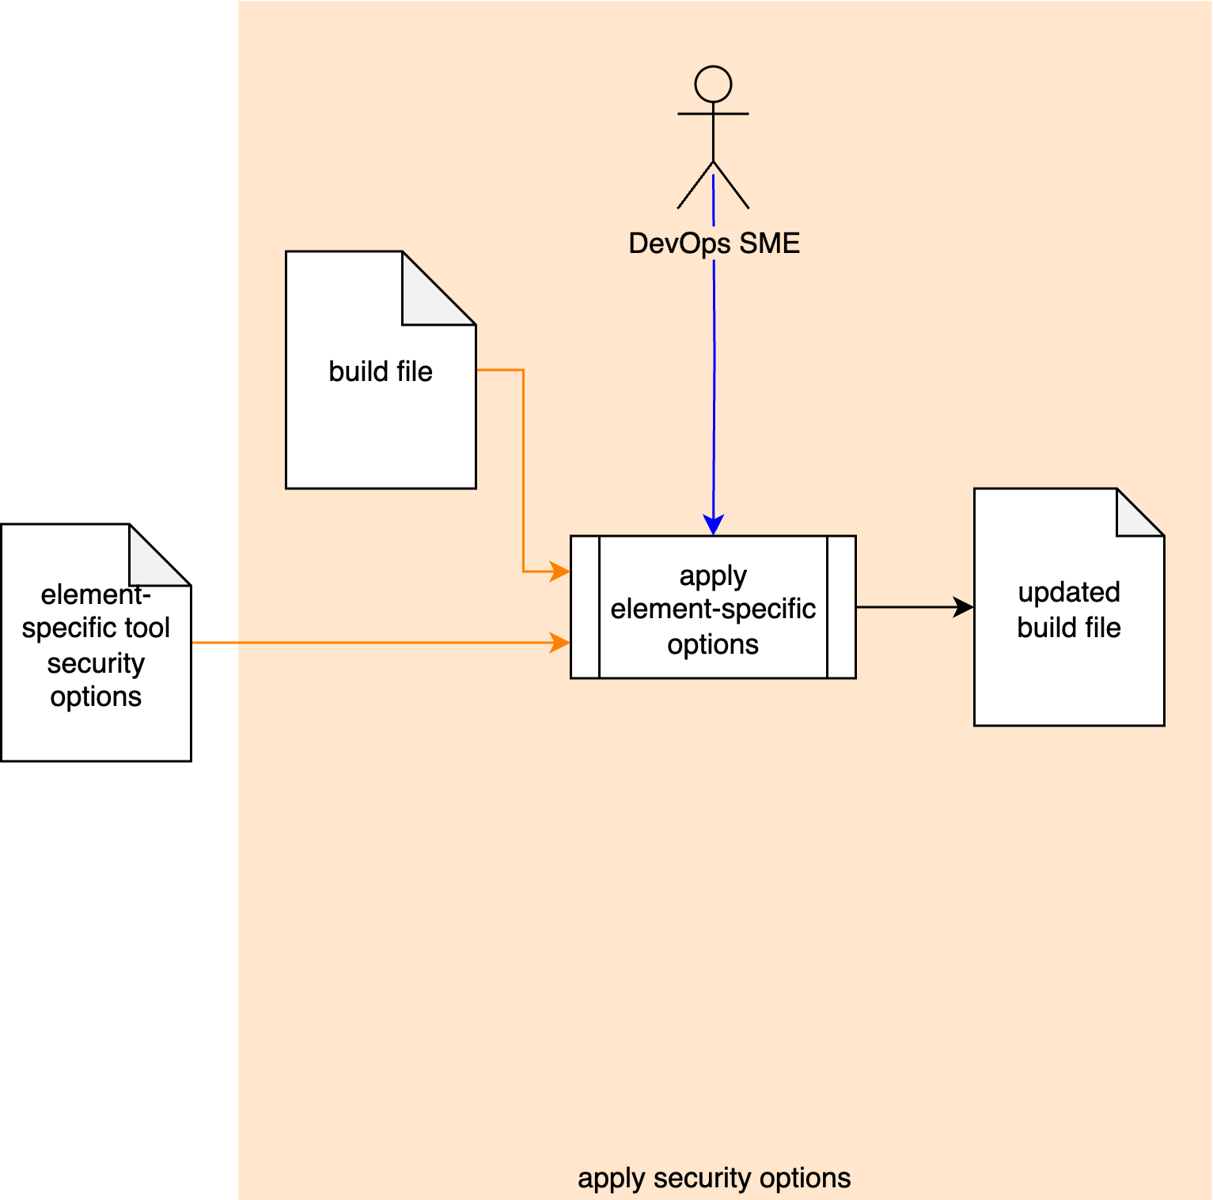
Secure Settings Process
Notes:
Script:
The secure settings process is comprised of four activities.
These are:
[break]
identifying the options relevant to security
[break]
categorizing those options
[break]
selecting which ones we're going to use for each element
[break]
and finally, applying those options to the build system for that element.

Slide 12
Secure Settings Material
Notes:
Script:

Slide 13
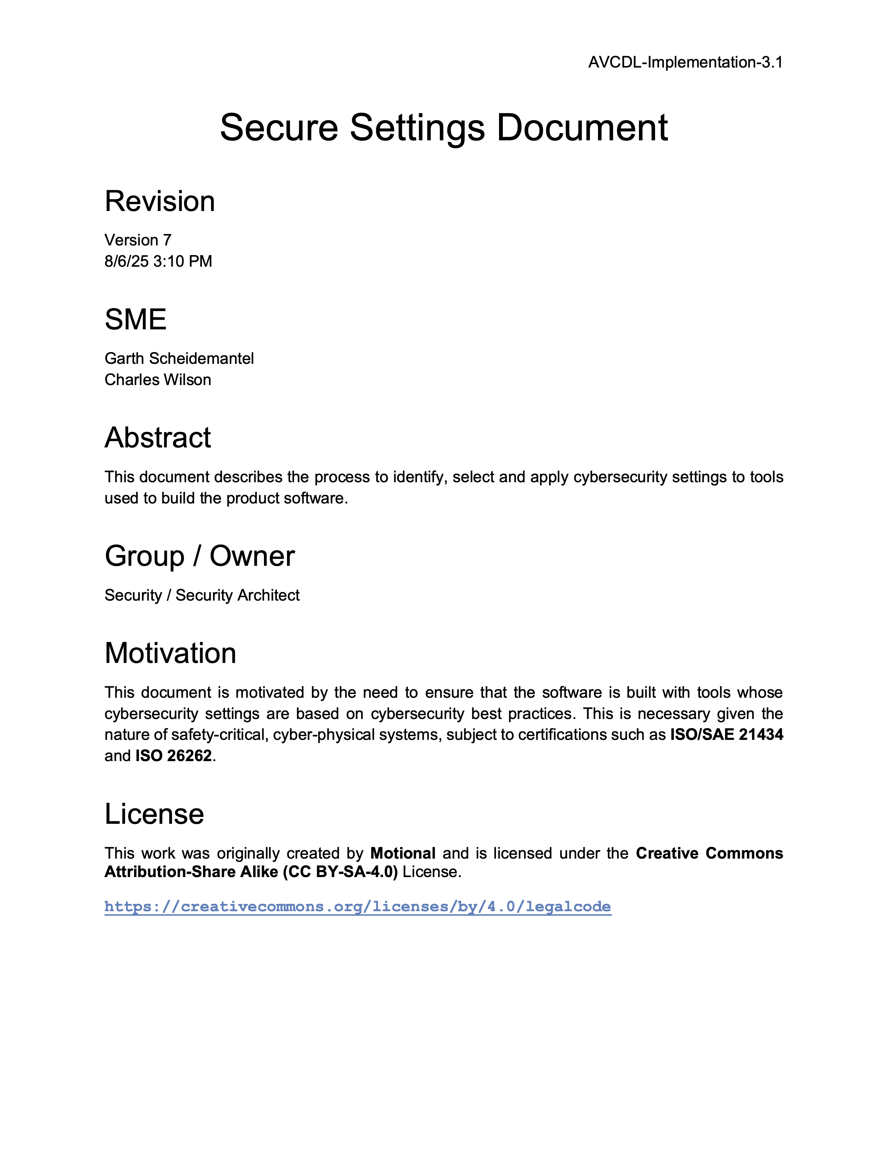
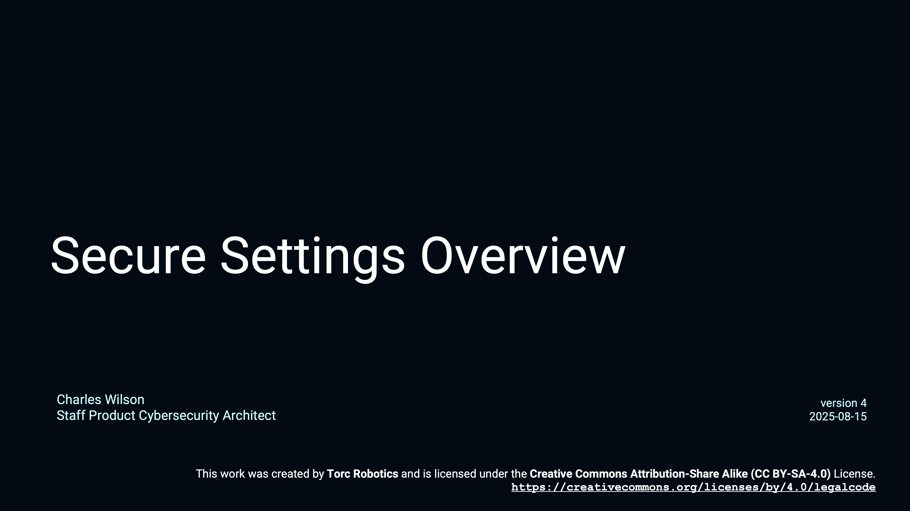
Secure Settings - Overview
Notes:
Script:
For additional information and to get a more in-depth set of references, the Secure Settings Document secondary document is available in the AVCDL GitHub repository.

Slide 14
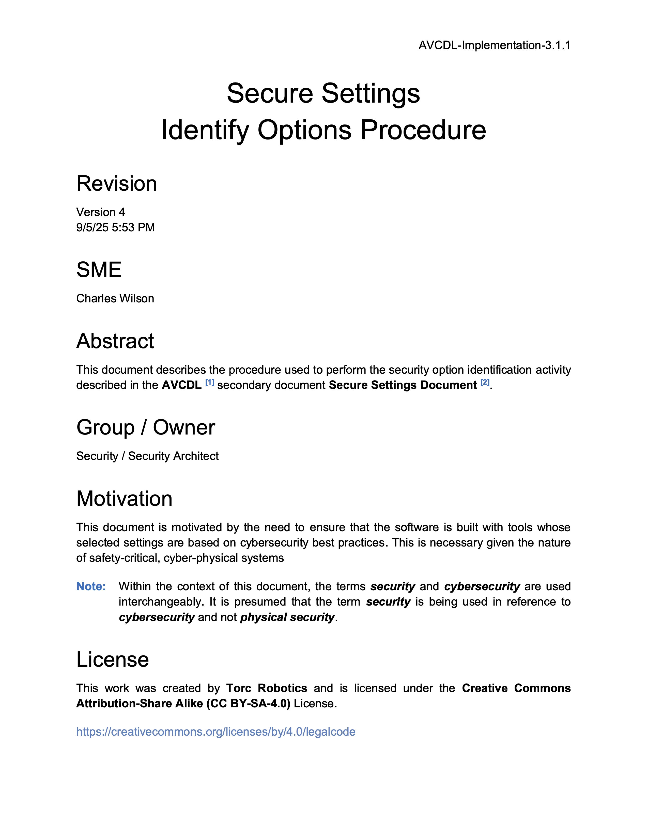
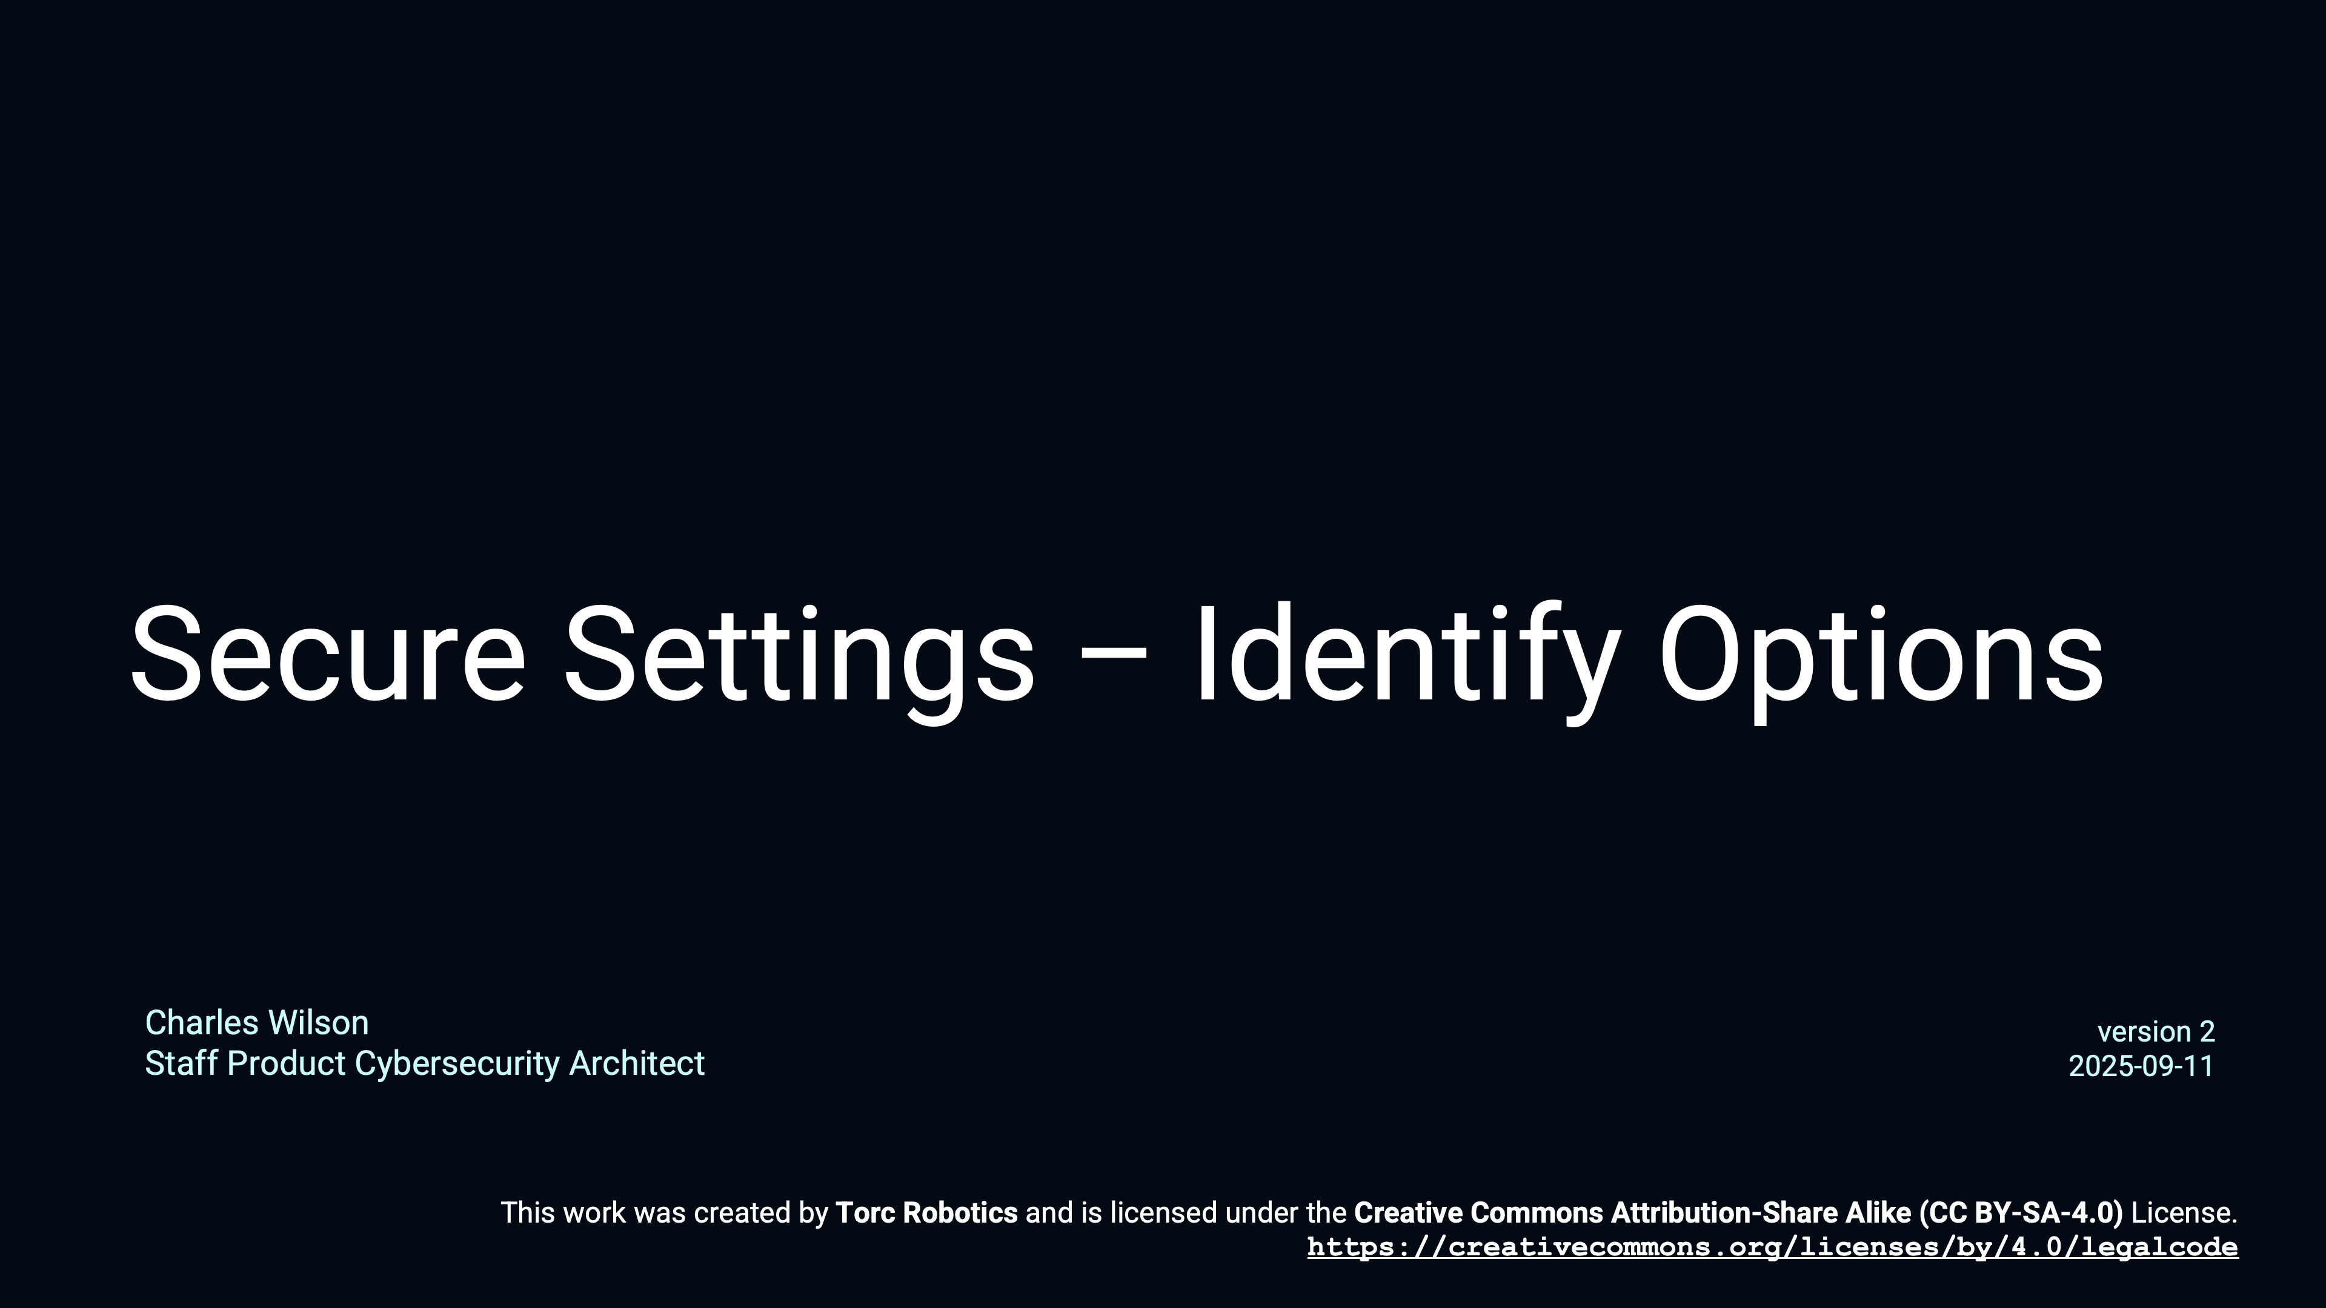
Secure Settings – Identify Options
Notes:
Script:
For additional information and to get a more in-depth set of references, the Secure Settings Document secondary document is available in the AVCDL GitHub repository.

Slide 15
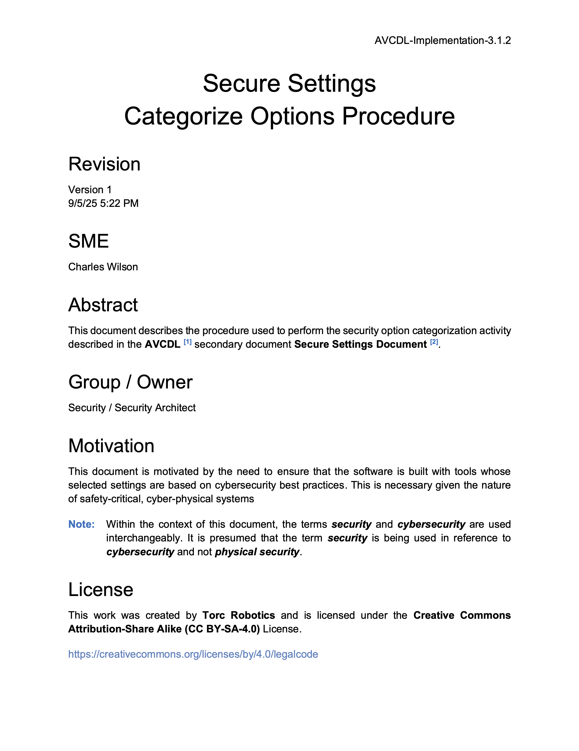
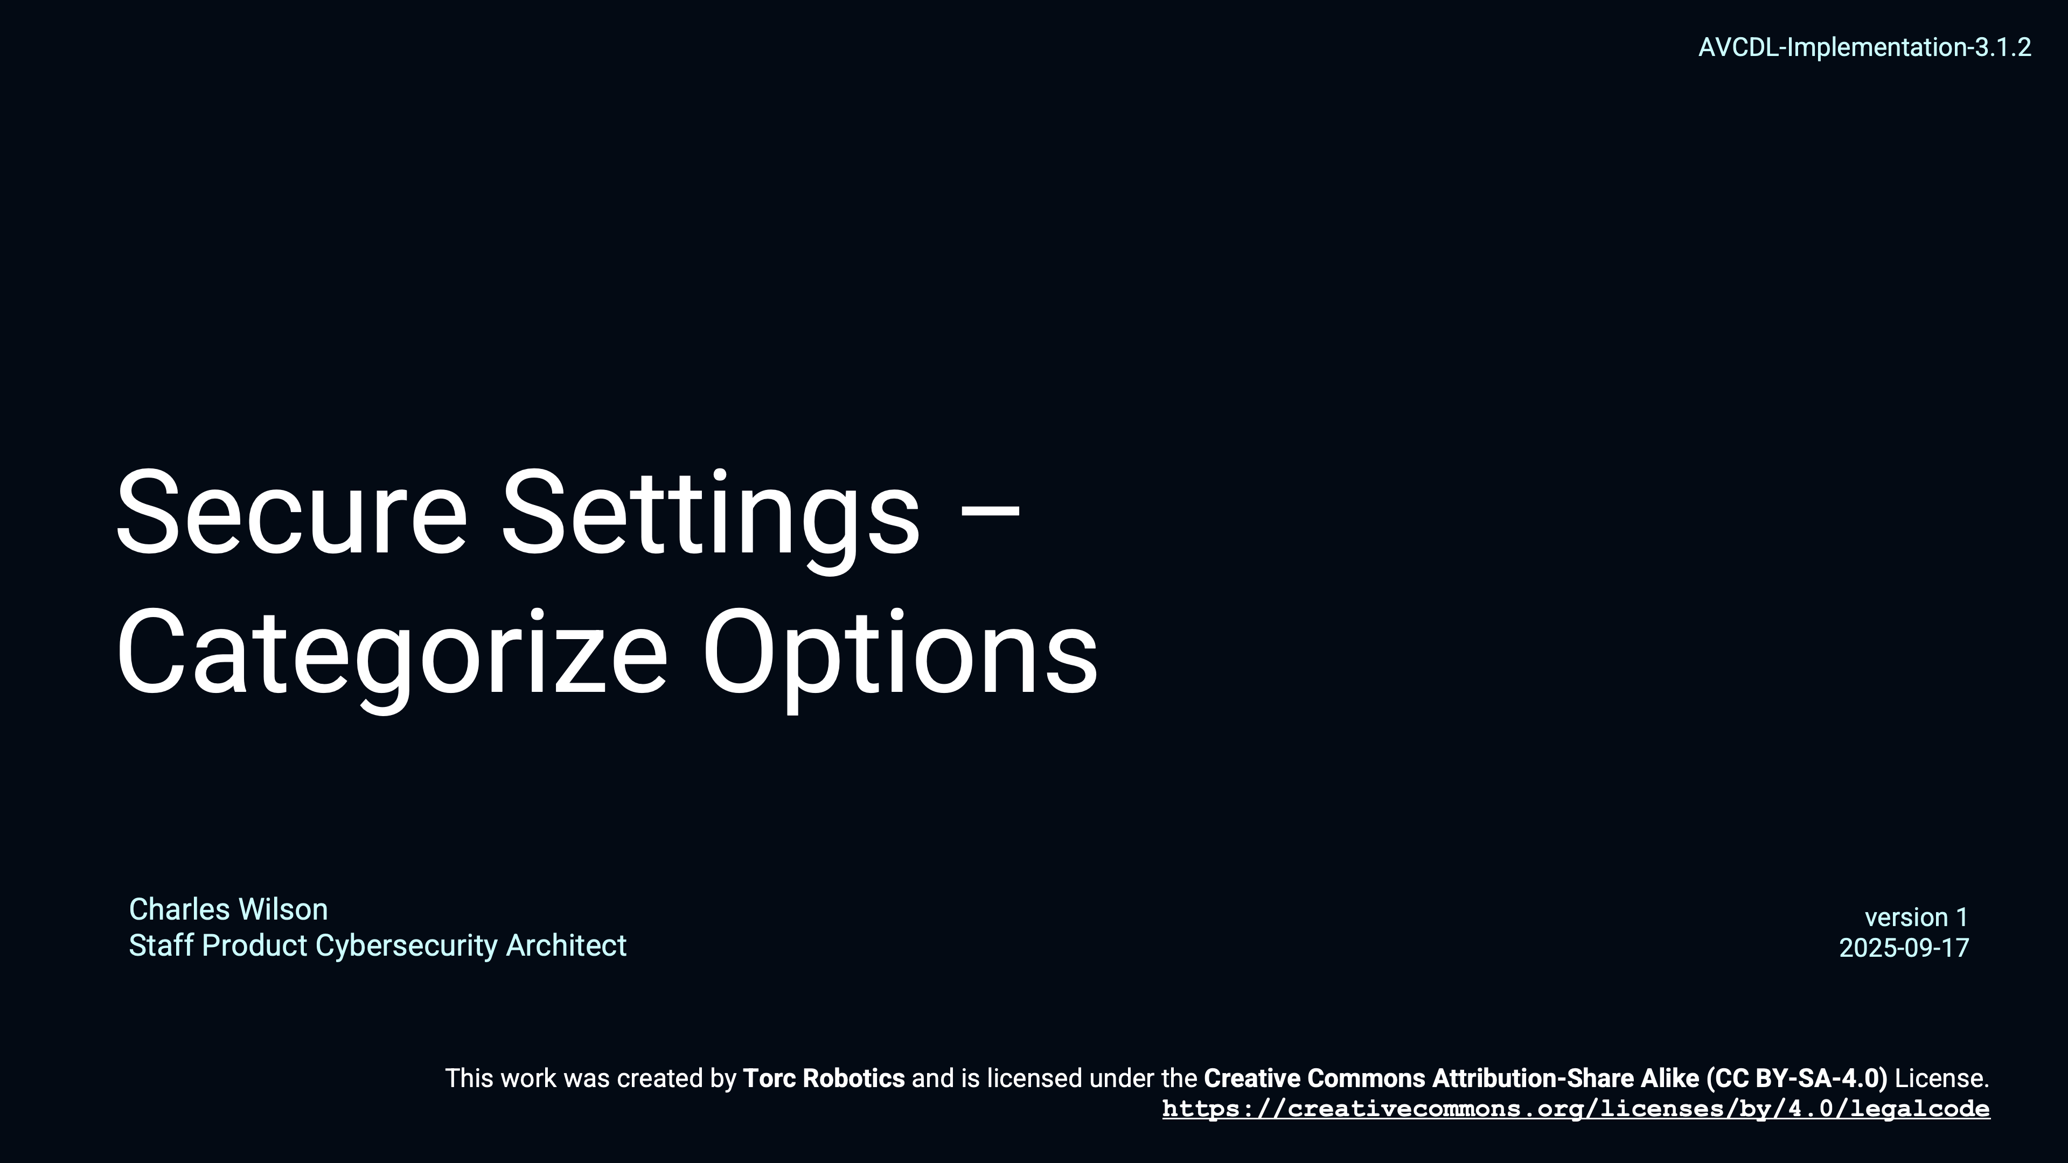
Secure Settings – Categorize Options
Notes:
Script:
For additional information and to get a more in-depth set of references, the Secure Settings Document secondary document is available in the AVCDL GitHub repository.

Slide 16
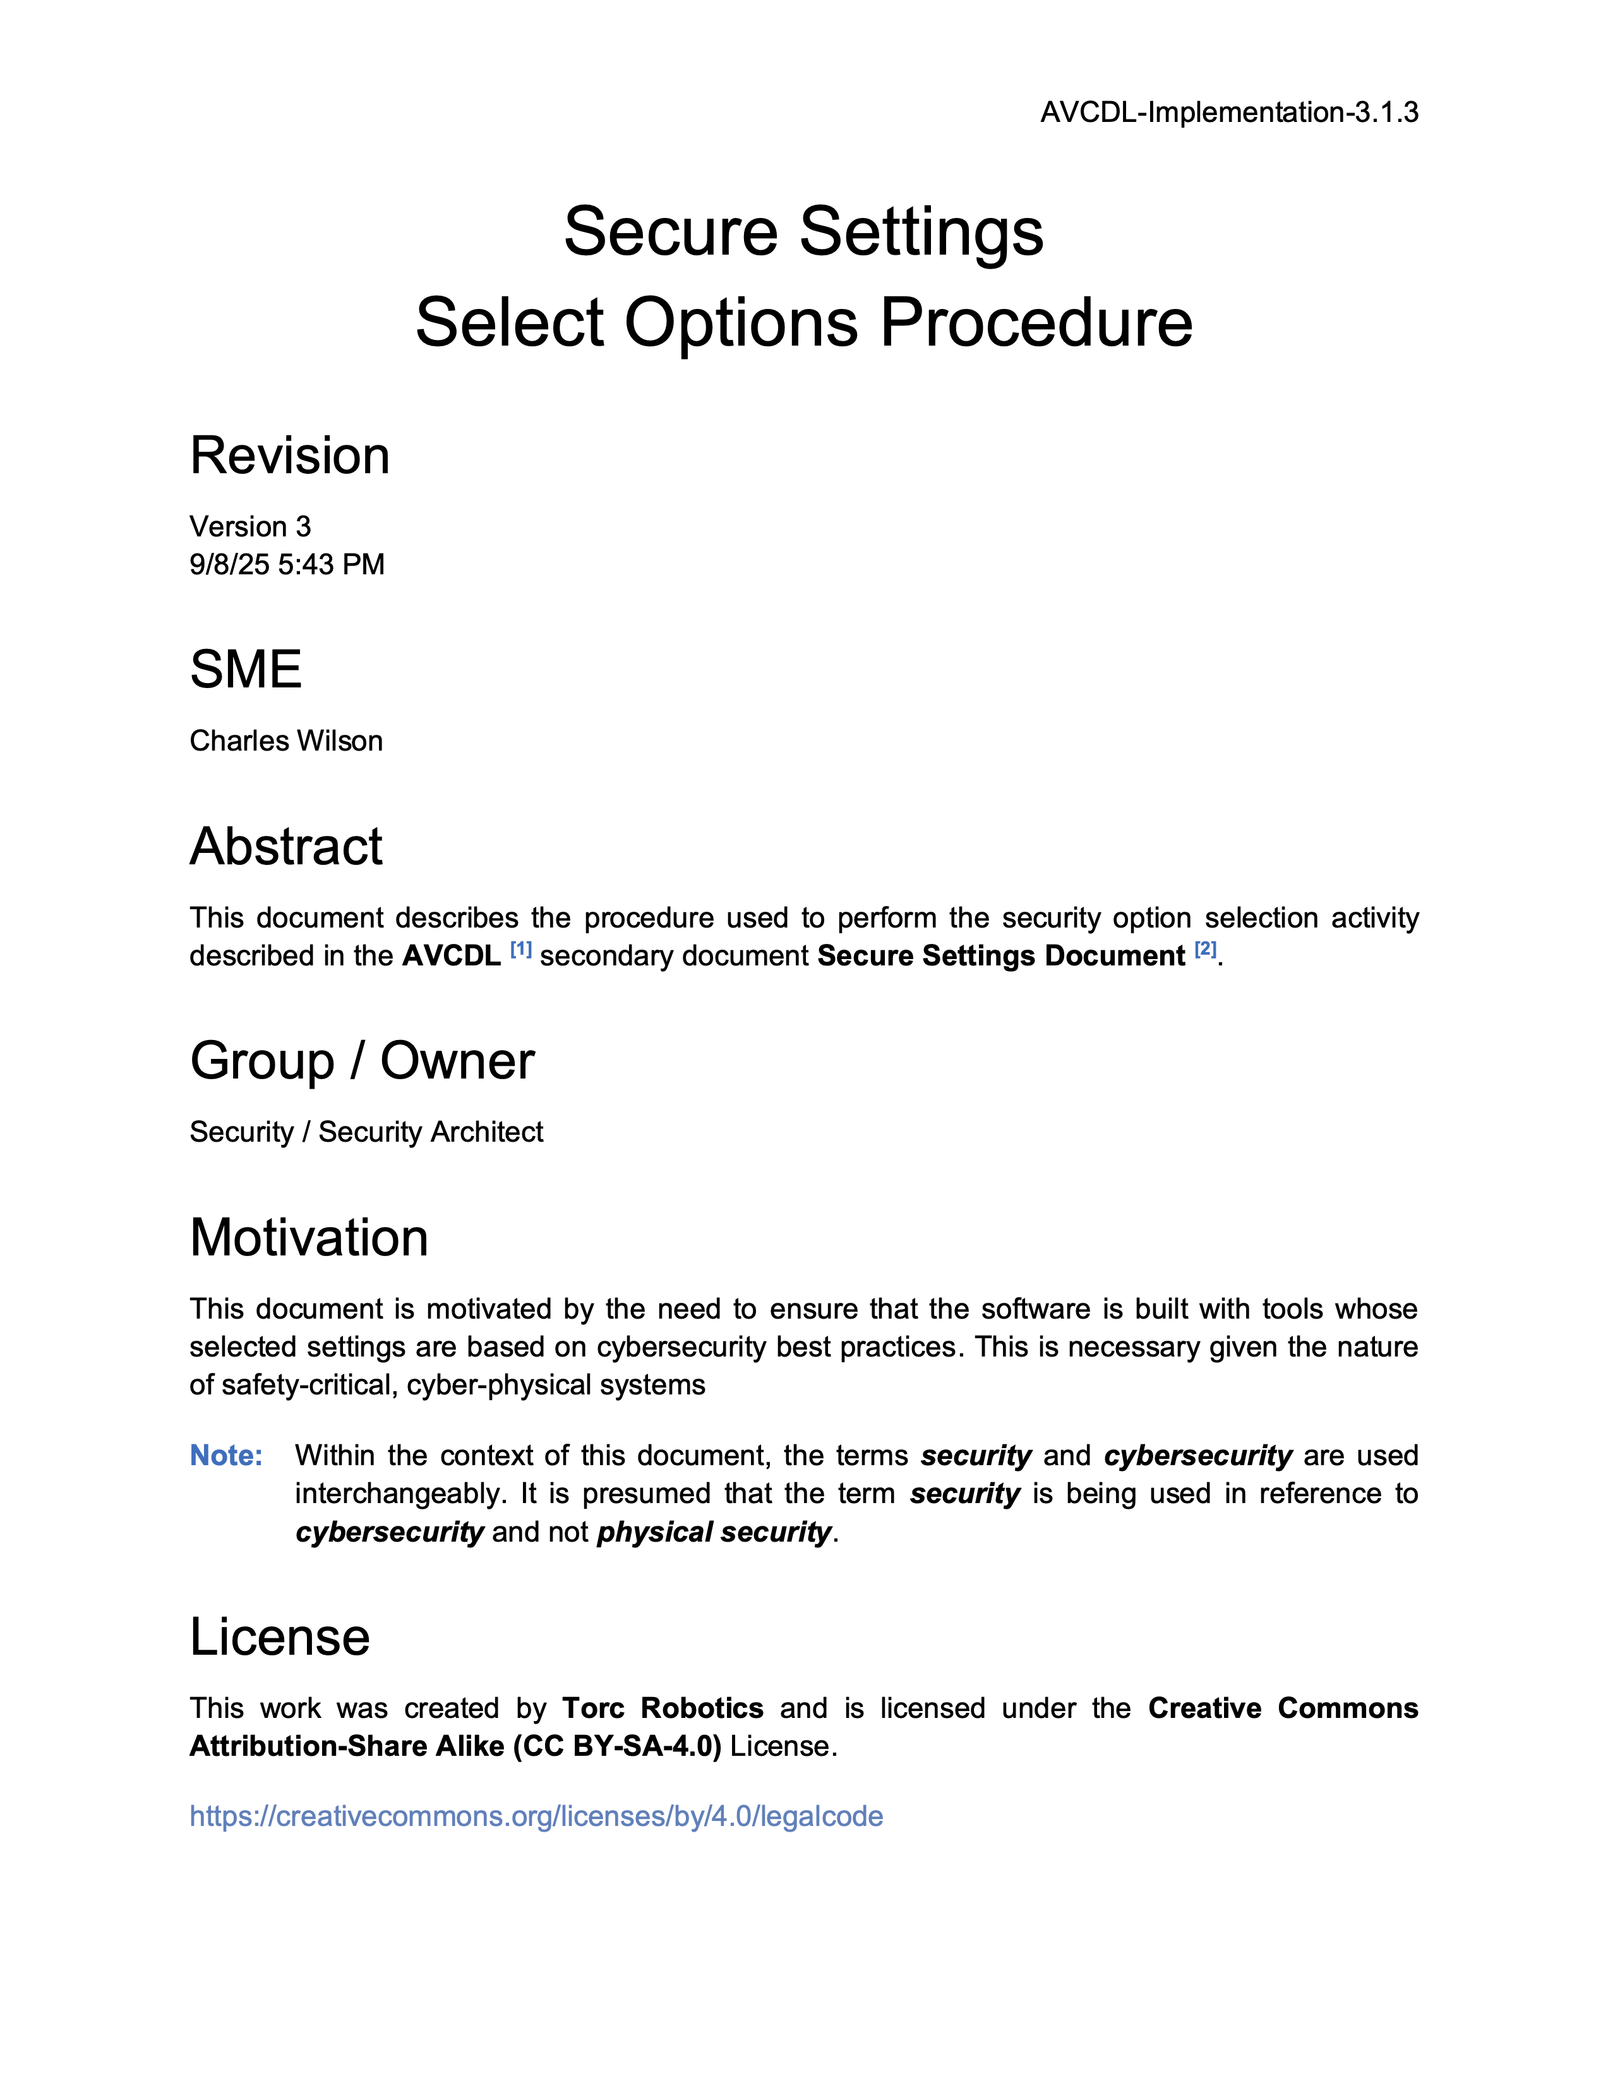
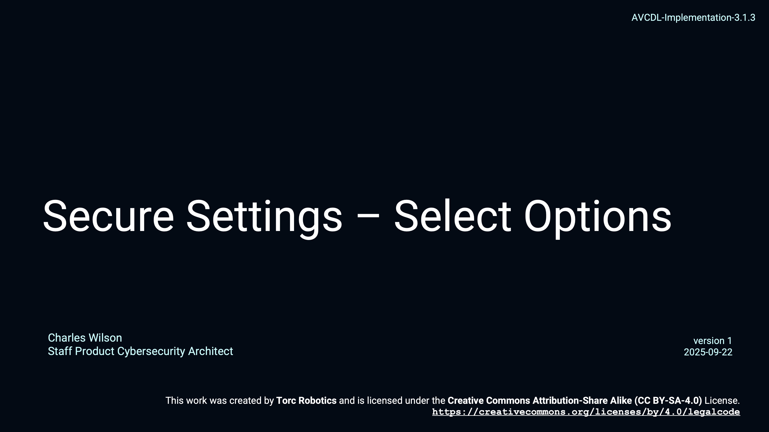
Secure Settings – Select Options
Notes:
Script:
For additional information and to get a more in-depth set of references, the Secure Settings Document secondary document is available in the AVCDL GitHub repository.

Slide 17

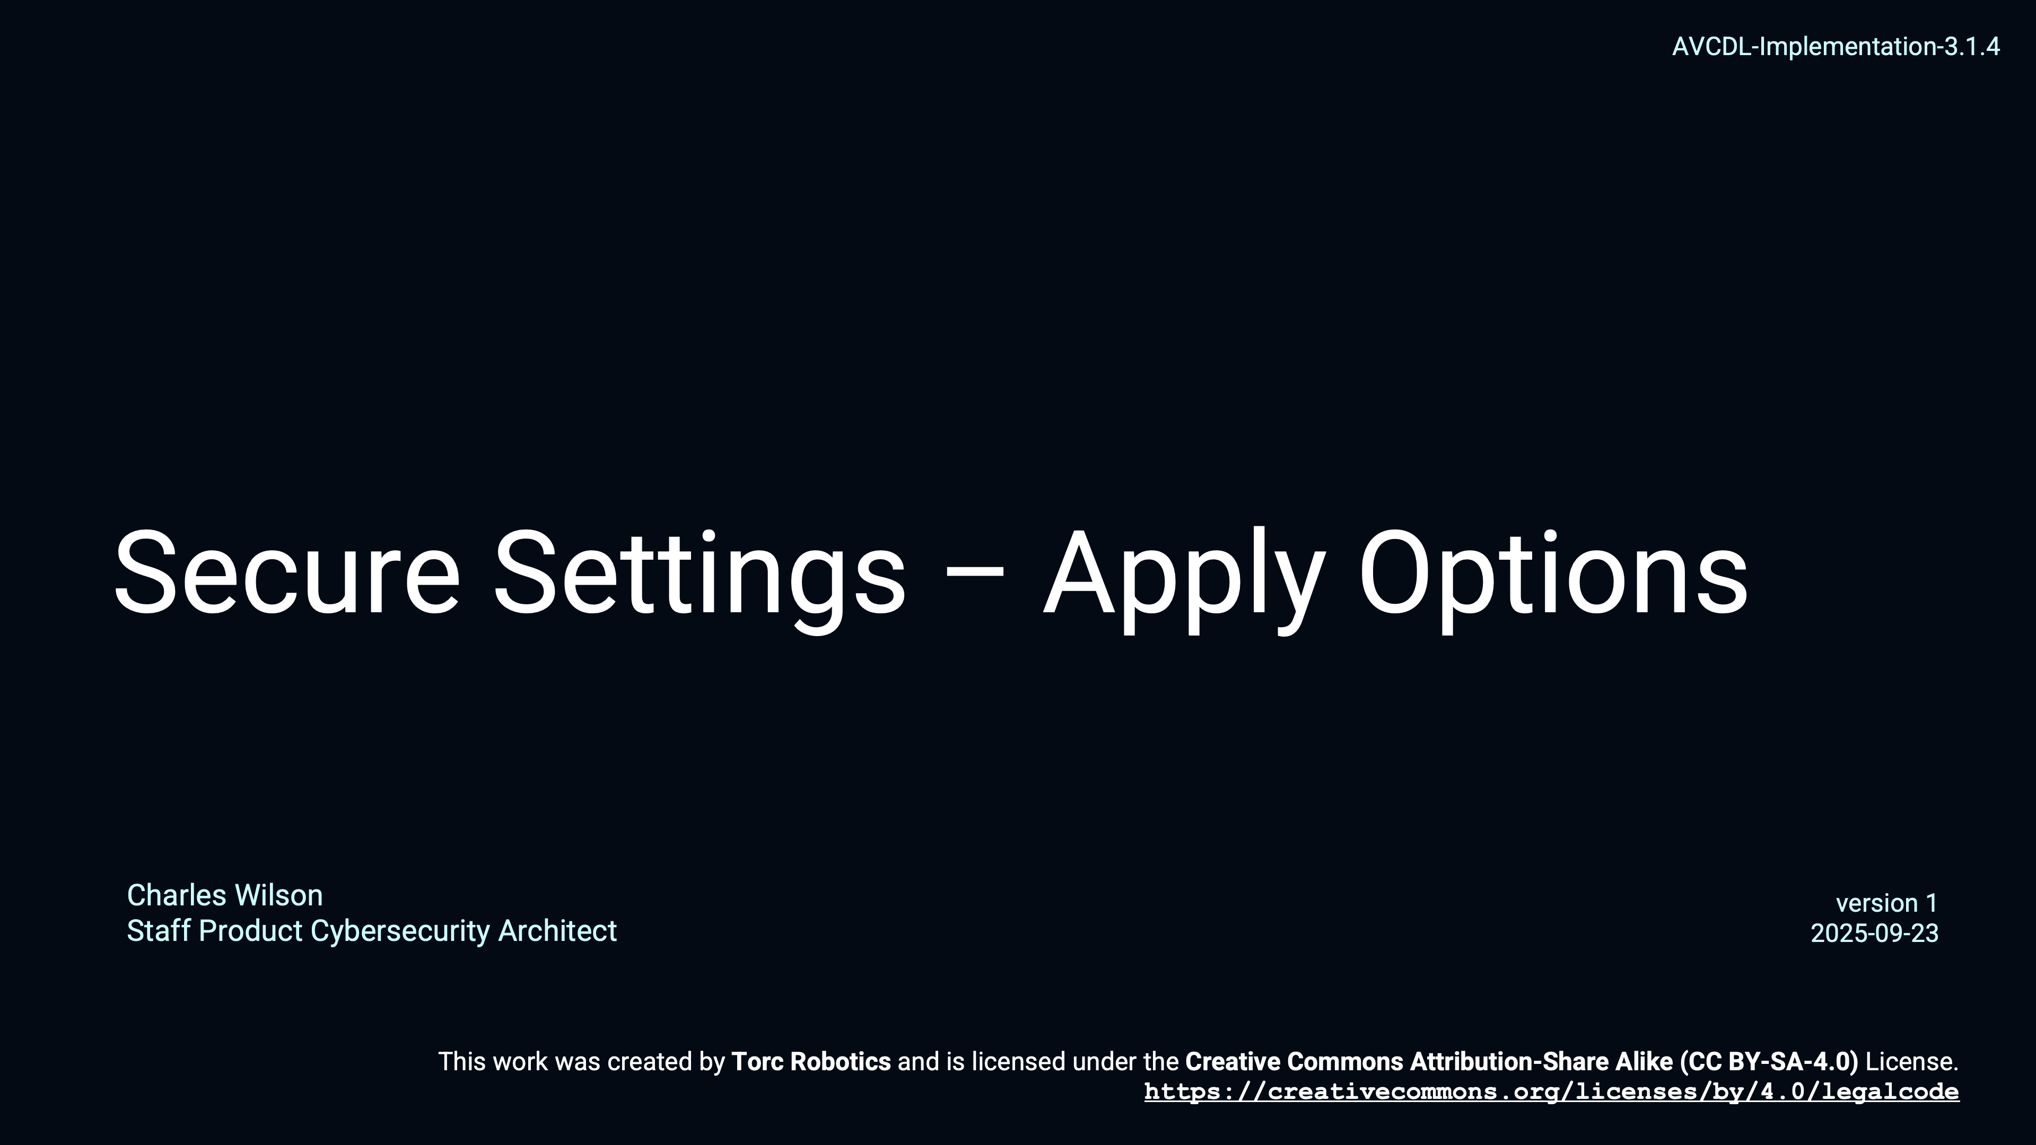
Secure Settings – Apply Options
Notes:
Script:
For additional information and to get a more in-depth set of references, the Secure Settings Document secondary document is available in the AVCDL GitHub repository.

Slide 18
Dynamic Analysis Considerations
Notes:
Script:

Slide 19
Considerations
Execution Time
Footprint
Notes:
Script:
Because we're impacting the build, it's important to consider the
[pause]
execution time
[pause]
and footprint
The reason for this is that since dynamic analysis is part of the test suite to be executed, it may well be time bounded.
And so, it's important to consider how that time bounding will be impacted by the addition of the dynamic analysis task.
The same thing is true for the footprint.
If you have instrumentation that's put into a test and attached to an element, regardless of what the scope of that element is, you may run into boundary conditions for the particular system the code is running on, and you have to be cognizant of that.

Slide 20
Recap
Notes:
Script:
That’s an overview of the process used in performing dynamic analysis.
Now let's review what’s been covered.

Slide 21
Summary
Select the options
Scope to the element
Update the build
Report the settings
Keep cybersecurity relevancy in mind
Notes:
Script:

Slide 22
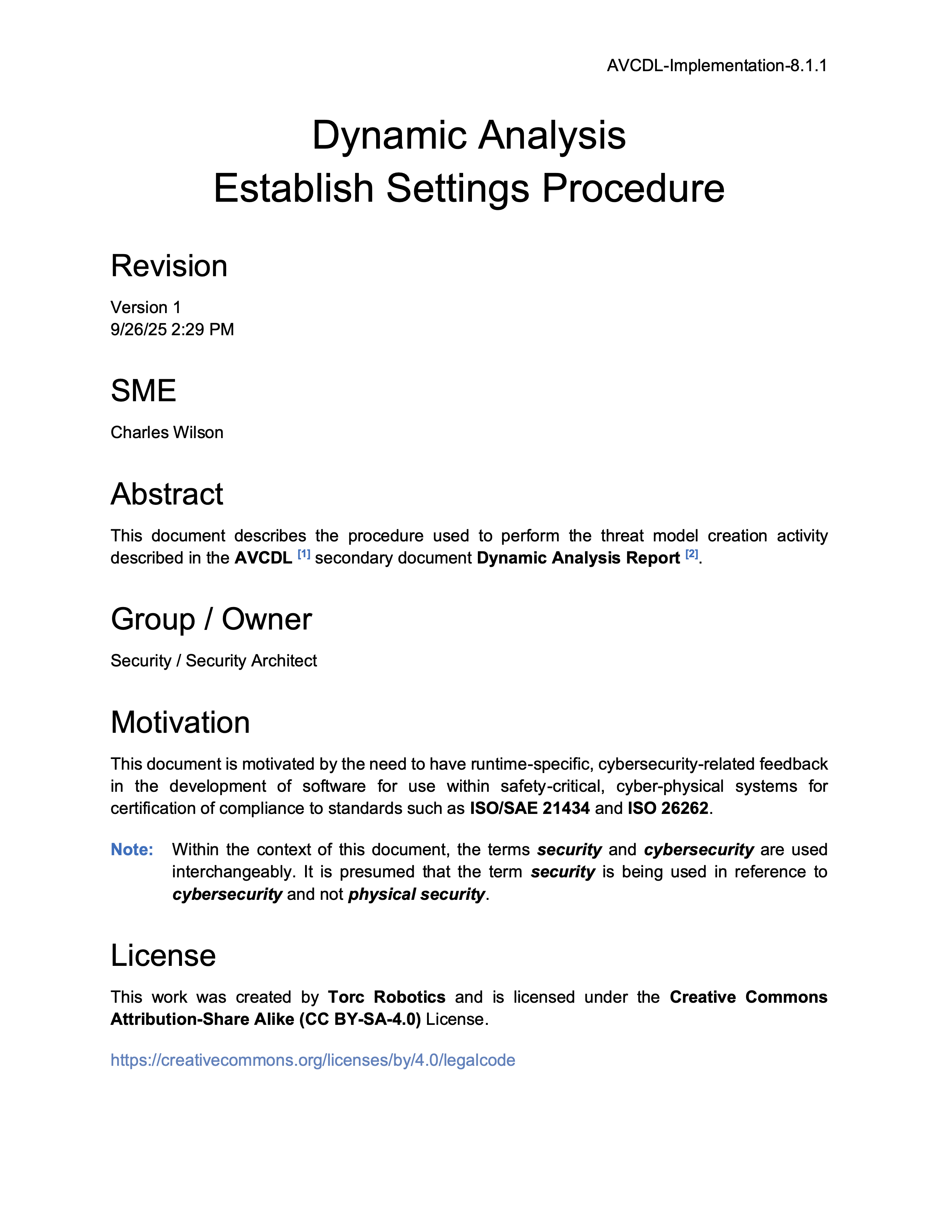
Further Reading
Notes:
Script:
For additional information and to get a more in-depth set of references, the Dynamic Analysis Establish Settings Procedure tertiary document is available in the AVCDL GitHub repository.

Slide 23
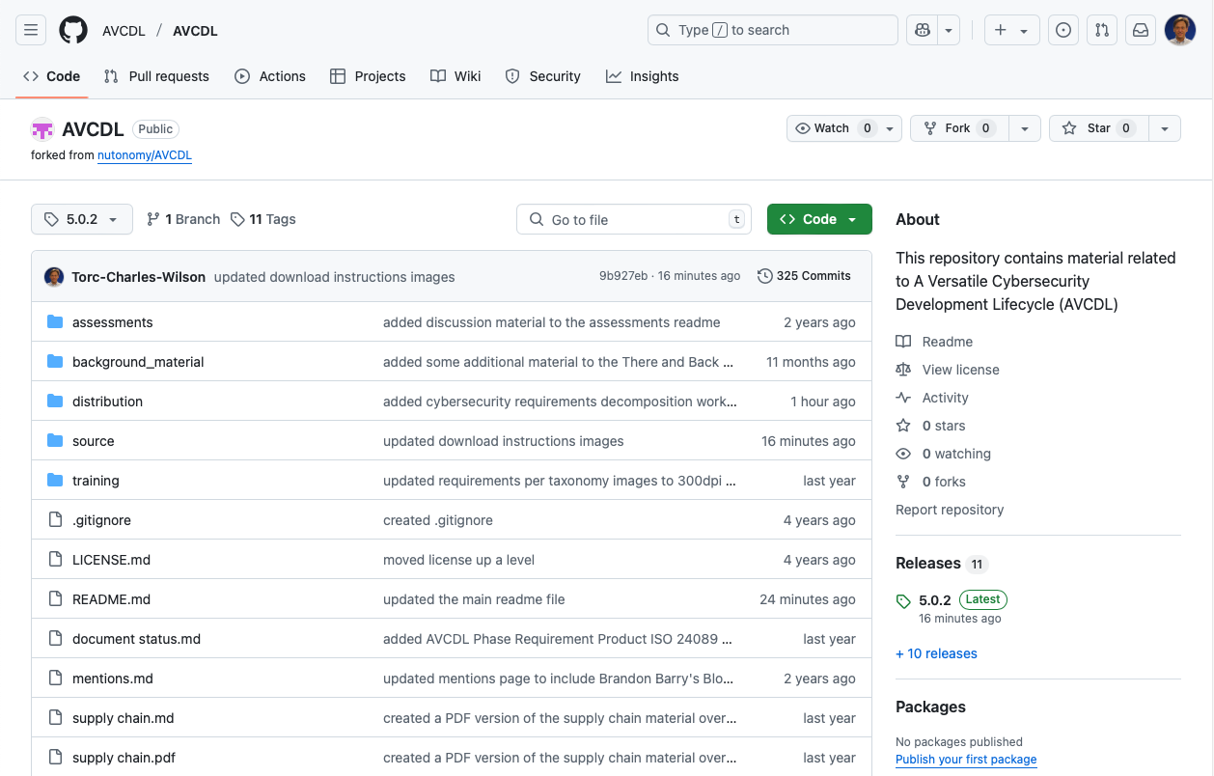
AVCDL on GitHub
https://github.com/AVCDL/AVCDL
Notes:
Script:
All AVCDL materials, both in source and distribution forms, are available on our GitHub site, as shown here.
Because of the size of the repository, it's recommended that you either clone the repository or download a ZIP archive of it, if you're not familiar with using git.
Instructions for downloading a ZIP archive are linked to on the repository’s front page.

Slide 24
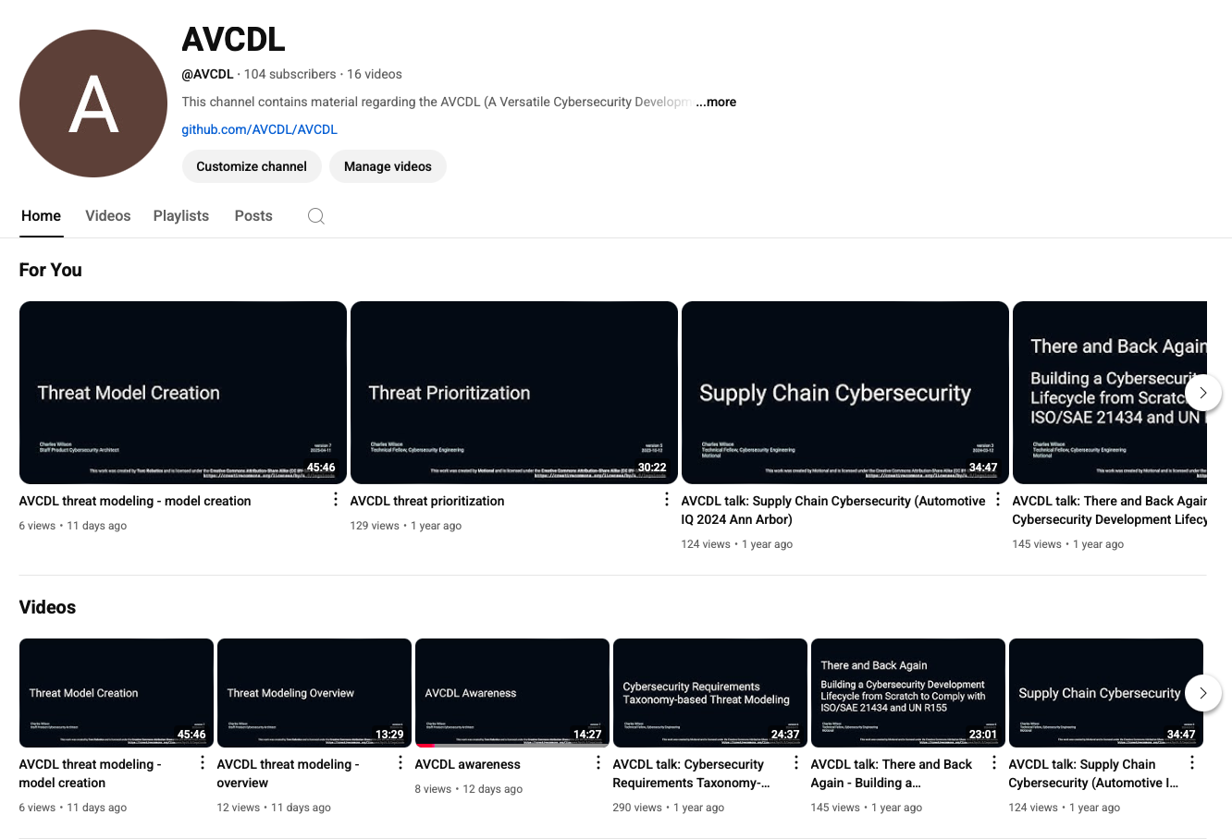
AVCDL on YouTube
https://youtube.com/@AVCDL
Notes:
Script:
Videos covering various aspects of the AVCDL are available on our YouTube channel, as shown here.
It's important to note that all AVCDL materials with the exception of the introductory blog posts are intended for product cybersecurity engineering practitioners.

Slide 25
Next Steps
Notes:
Script:
With this training complete, if you’ve completed the other trainings covering the Dynamic Analysis process activities, you can proceed to the other training at this level, these include:
Static Analysis
Fuzz Testing
and
Secure Code Review

Slide 26
References (1 of 2)
AVCDL primary document
Dynamic Analysis Report (AVCDL secondary document)
Dynamic Analysis – Establish Settings Procedure (AVCDL tertiary document)
Secure Settings Document (AVCDL secondary document)
Secure Settings – Identify Options Procedure (AVCDL tertiary document)
Secure Settings – Categorize Options Procedure (AVCDL tertiary document)
Secure Settings – Select Options Procedure (AVCDL tertiary document)
Secure Settings – Apply Options Procedure (AVCDL tertiary document)
AVCDL tool cybersecurity options template (AVCDL template)
AVCDL element-specific tool cybersecurity options template (AVCDL template)
Notes:
Script:
Here are the references to the source material used in the creation of this presentation.
They'll also be included in the video description.
Additionally, this presentation’s source material will be provided on the AVCDL GitHub repository.

Slide 27
References (2 of 2)
Address Sanitizer [LLVM]
https://clang.llvm.org/docs/AddressSanitizer.html
Thread Sanitizer [LLVM]
https://clang.llvm.org/docs/ThreadSanitizer.html
Memory Sanitizer [LLVM]
https://clang.llvm.org/docs/MemorySanitizer.html
Leak Sanitizer [LLVM]
https://clang.llvm.org/docs/LeakSanitizer.html
Undefined Behavior Sanitizer [LLVM]
https://clang.llvm.org/docs/UndefinedBehaviorSanitizer.html
Notes:
Script:
Here are the references to the source material used in the creation of this presentation.
They'll also be included in the video description.
Additionally, this presentation’s source material will be provided on the AVCDL GitHub repository.

